Slide 1


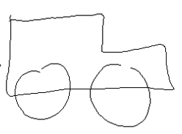
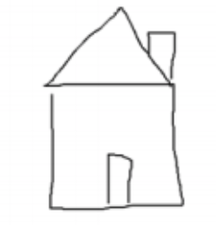
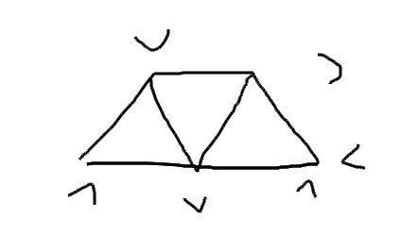
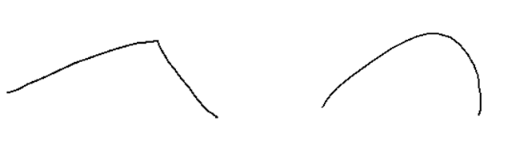
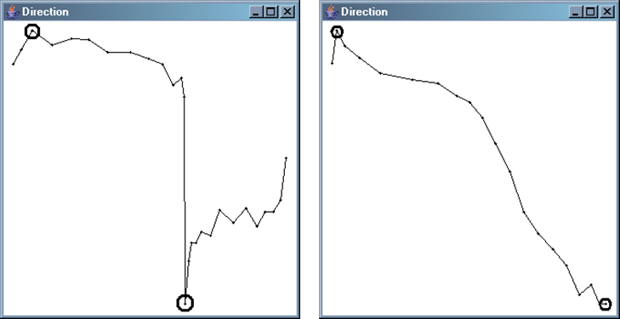
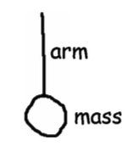
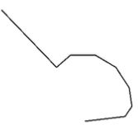
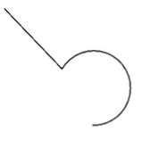
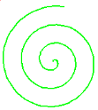

No Rubine: Using Geometric-based Features for Sketch Recognition
Chao Gu, Aniket Bonde, Dr. Tracy Hammond, Paul Taele
Texas A&M University
Abstract
Non-Rubine Features
Implementation
Complex shapes can be constructed hierarchically as a combination of smaller primitive shapes meeting certain geometric constraints. However, in order to construct higher level shapes, it is imperative to accurately recognize the lower-level primitives. Gesture features like Rubine features require extensive training. More signiﬁcantly, results from feature subset selection indicate that geometric features aid the recognition process more than gesture-based features when given naturally sketched data.
Complex shapes can be constructed hierarchically as a combination of smaller primitive shapes meeting certain geometric constraints. It is imperative to accurately recognize the lower-level primitives. Geometric features aid the recognition process more when given naturally sketched data, like following:
Pre-Recognition:
Remove duplicates, Compute Graphs, Remove Tails, Overtraced Test, Closed shape Test, Corner Dection
NDDE and DCR
NDDE: Normalized distance between direction extremes
DCR: Direction change ratio
Complex Shapes Recognition:
Geometric Features:
Stroke
31 features are geometric-based (44 features in total [1]) 14 optimal geometric features selected based on Polyline and Complex test in PaleoSketch system
What are Rubine’s Features?
They are the following listed gesture based features for sketch recognition:
Low-level recognizer
Line, Polyline, Circle, Ellipse, Arc, Curve, Spiral, Helix, etc.
Stroke
Cosine of initial angle
Sine of initial angle
Size of bounding box
Angle of bounding box
Distance between first and last points
Cosine of angle between first and last points
Sine of angle between first and last points
Total length
Total angle
Total absolute angle
Sharpness
Total Time
Maximum Speed
High-level recognizer
NDDE = 0.551
NDDE = 0.995 [2]
Arrow, Pendulum, etc.
Pre-recognition
Polylines
Ellipses
Sub-strokes pass line test
Area error less than threshold
High DCR value
Pass closed shape test
Area error less than threshold
High NDDE value
Final sketch interpretation
Shape Tests
Line Test
Polyline Test
Low-level Recognizer:
High-level Recognizer:
Circle Test
Ellipse Test
Results
Support primitive shapes
Accurate
Natural drawn
Handle noise and orientations
Shapes drawn in any order
Any number of strokes
Interspersed
 | Without Geometric Features | With Geometric Features
Accuracy (Correct Interpretation) | 93.33 % | 99.89 %
Accuracy (Top Correct Interpretation) | 67.56 % | 98.56 %
Arc Test
Curve Test
Spiral Test
Helix Test
Why Rubine’s Features Fail?
Passed, Error, Beautified Shape
Gesture features require extensive training
Strokes has to be drawn in the same manner each time.
Rubin features are proved to be helpful in recognizing two-dimensional gestures, but not for natural sketch recognition problems. The accuracy of these approaches is not optimal.
Line
Polyline
Hierarchy and Ranking Algorithm
Circle
Ellipse
Pendulum constructed from lower level primitives (line, circle)
Line (1), Arc (3), Curve (5), Circle (5), Ellipse (5), Helix (5), Spiral (5)
Arc
Curve
References
[1] Paulson, B., Hammond T., PaleoSketch: accurate primitive sketch recognition and beautification, Proceedings of the 13th international conference on Intelligent user interfaces, January 13-16, 2008, Gran Canaria, Spain.
[2] Paulson, B., Rajan, B., Davalos, P., Hammond, T., Gutierrez-Osuna, R., What!?! No Rubine Features?: Using Geometric-based Features to Produce Normalized Conﬁdence Values for Sketch Recognition.
Spiral
Helix
Polyline Interpretation
8 lines
Score: 8
Polyline Interpretation
1 line and 1 arc
Score: 4

